Slide 1

Applied Problem Solving Techniques
Introduction to Python for Industrial Engineering
Week 1
Asst.Prof. Bülent ŞİMŞEK
(2025 - 2026)

Slide 2
Applied Problem Solving Techniques
Imagine you are an industrial engineer working in a manufacturing facility.
One morning, you notice that the stock level of a key product is dropping rapidly. A new order has been placed, but the delivery is still in transit.
At the same time, a machine on the production line comes to an unexpected stop. The shift supervisor has executed the work orders in the wrong sequence.
The production schedule collapses, and shipments are delayed. The customer, dissatisfied, cancels the order.
A delayed supply. A halted operation. A lost customer.
What if you could foresee these issues before they happened?
What if you could make fast, data-driven, intelligent decisions—before it was too late?

Slide 3

Applied Problem Solving Techniques
AI is no longer a trend — it's a necessity in modern supply chains. It predicts, optimizes, and prevents. This course will help you gain that same problem-solving power — through real data, real tools, and real impact.
How AI Is Transforming Supply Chain Management - Real-World Applications

Slide 4
How AI Is Transforming Supply Chain Management
Demand Forecasting
AI predicts future demand using data and trends, helping avoid overstocking or shortages while reducing costs.
Inventory Management
AI helps keep optimal stock levels, lowering storage costs and preventing stockouts.
Logistics and Transportation
AI uses real-time data to optimize delivery routes, saving fuel, reducing costs, and speeding up deliveries.
Risk Management
AI detects potential risks early and suggests solutions before disruptions occur.
Automation of Routine Tasks
AI automates routine tasks, reduces errors, and lets employees focus on strategic work.
Improved Competitiveness
AI enables faster decisions, better operations, and stronger competitiveness.

Slide 5



Installation
Python
PyCharm

Slide 6

PyCharm

Slide 7
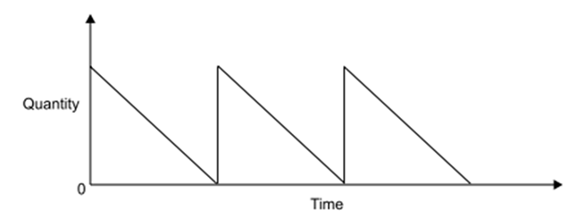
Economic Order Quantity (EOQ)
The amount of material stored over time can be shown on an inventory-time diagram, with Q on the vertical axis and the time on the horizontal axis. The total time period (one year) is divided into n parts.

Slide 8
Economic Order Quantity (EOQ)
Inventory models deal with idle resources like men, machines, money and materials.
These models are concerned with two decisions:
how much to order (purchase or produce)
when to order so as to minimize the total cost.
For the first decision—how much to order, there are two basic costs are considered namely,
inventory carrying costs
ordering or acquisition costs.
As the quantity ordered is increased, the inventory carrying cost increases while the ordering cost decreases.

Slide 9
Economic Order Quantity (EOQ)
The ‘order quantity’ means the quantity produced or procured during one production cycle.
Economic order quantity is calculated by balancing the two costs. (EOQ) is that size of order which minimizes total
costs of carrying
cost of ordering.
i.e., Minimum Total Cost occurs when
Inventory Carrying Cost = Ordering Cost
Economic order quantity can be determined by two methods:
1. Tabulation method.
2. Algebraic method.

Slide 10
First Try
A small-scale warehouse wants to reduce inventory costs by ordering products in economical quantities.
The manager also wants to monitor inventory levels daily and place new orders when critical inventory levels fall. Once ordered, products arrive at the warehouse within three days.
Information | Value
Annual Demand (D) | 1200 | units
Order Cost (S) or (C₃) | 100 | $
Unit Inventory Cost (H) or (C₁) | 5 | $
Starting Stock Quantity | 200 | units
Critical Level | 50 | units
Delivery Time | 3 | days
Daily Demand | 4 | units

Slide 11
Tabulation
#n of orders / year | Lot Size | Average Inventory | Inventory Cost | Ordering Cost | Total Cost
1 | 1200 | 600 | 3000 | 100 | 3100
2 | 600 | 300 | 1500 | 200 | 1700
4 | 300 | 150 | 750 | 400 | 1150
8 | 150 | 75 | 375 | 800 | 1175
12 | 100 | 50 | 250 | 1200 | 1450
16 | 75 | 37,5 | 187,5 | 1600 | 1787,5

Slide 12
Tabulation
#n of orders / year | Lot Size | Average Inventory | Inventory Cost | Ordering Cost | Total Cost
1 | 1200 | 600 | 3000 | 100 | 3100
2 | 600 | 300 | 1500 | 200 | 1700
4 | 300 | 150 | 750 | 400 | 1150
8 | 150 | 75 | 375 | 800 | 1175
12 | 100 | 50 | 250 | 1200 | 1450
16 | 75 | 37,5 | 187,5 | 1600 | 1787,5

Slide 13
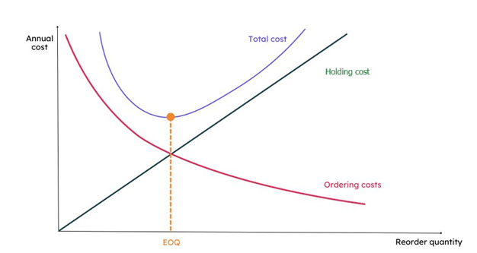
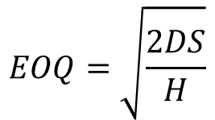
First Try
Calculate the Economic Order Quantity
$$EOQ=\sqrt{\frac{2DS}{H}}$$
import math D = 1200 S = 100 H = 5 eoq = math.sqrt((2 * D * S) / H) print("EOQ:", round(eoq))
python.exe First_Try.py
EOQ: 219
Process finished with exit code 0

Slide 14
First Try
Suggest order if stock falls below critical level
current_stock = 40 critical_level = 50 if current_stock < critical_level: print("Warning: Stock below critical level. Reorder required.") else: print("Stock level is sufficient.")

Slide 15
First Try
Stock decreases by 4 every day. Delivery arrives in 3 days. Will the supply arrive before the stock reaches zero?
stock = 60 daily_demand = 4 days_until_delivery = 3 day = 1 while day <= days_until_delivery: stock -= daily_demand print(f"Day {day}: Stock = {stock}") day += 1 if stock <= 0: print("Stockout occurred before delivery!") else: print("Delivery arrived in time.")

Slide 16
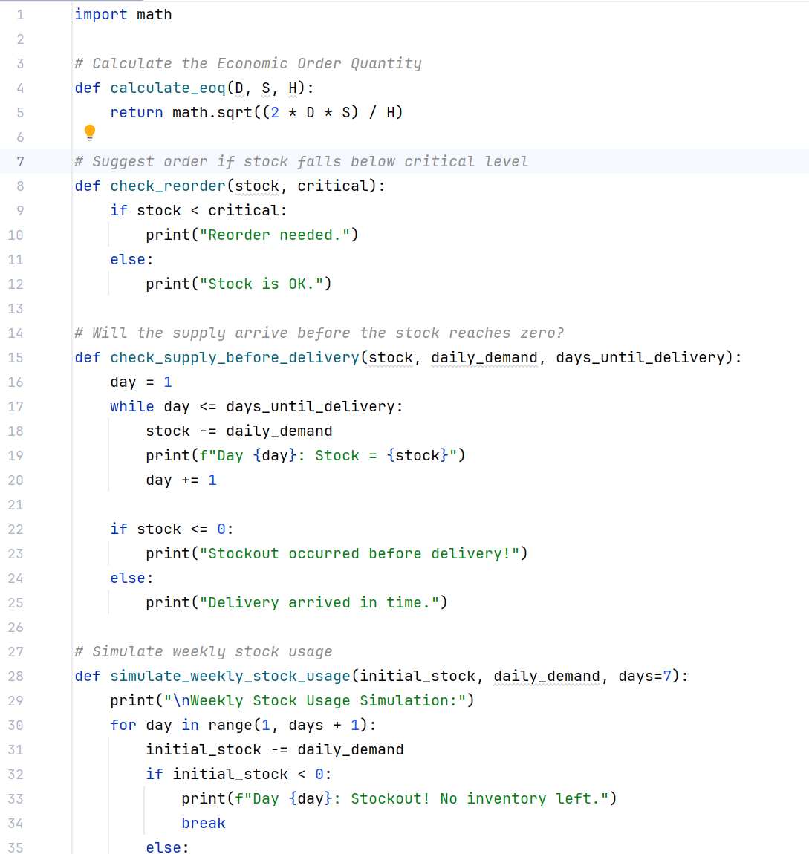
First Try
Let's make all these functions

Slide 17
First Try
Write a function as:
simulate_weekly_stock_usage(initial_stock, daily_demand, days=7)
def simulate_weekly_stock_usage(initial_stock, daily_demand, days=7): print("\nWeekly Stock Usage Simulation:") for day in range(1, days + 1): initial_stock -= daily_demand if initial_stock < 0: print(f"Day {day}: Stockout! No inventory left.") break else: print(f"Day {day}: Remaining Stock = {initial_stock}")

Slide 18
First Try
How many days' supply will the current stock last?
How many days' supply can the EOQ meet?
If the stock drops to zero before a new order arrives, on which day will it drop?
Suggest order if stock falls below critical level; Re-evaluate by getting new stock value and critical level from the user.
Assuming we always order the EOQ amount and it takes delivery_days to arrive, how frequently should we place orders so that we don’t run out of stock while waiting?
Notes:
days_covered = stock // daily_demand
print(f"Current stock is sufficient for {days_covered} full days.")
-------------------------------------------------------------------------
days_from_eoq = int(eoq) // daily_demand
print(f"EOQ quantity will meet demand for approximately {days_from_eoq} days.")
-------------------------------------------------------------------------
def simulate_stock_until_delivery(stock, daily_demand, delivery_days):
for day in range(1, delivery_days + 1):
stock -= daily_demand
if stock <= 0:
print(f"Stockout occurs on day {day}")
break
else:
print(f"Day {day}: Stock = {stock}")
-------------------------------------------------------------------------
annual_demand = 1200
eoq = int(calculate_eoq(1200, 100, 5))
orders = 0
remaining = annual_demand
while remaining > 0:
remaining -= eoq
orders += 1
print(f"Required number of EOQ orders: {orders}")
***************************************************

Slide 19
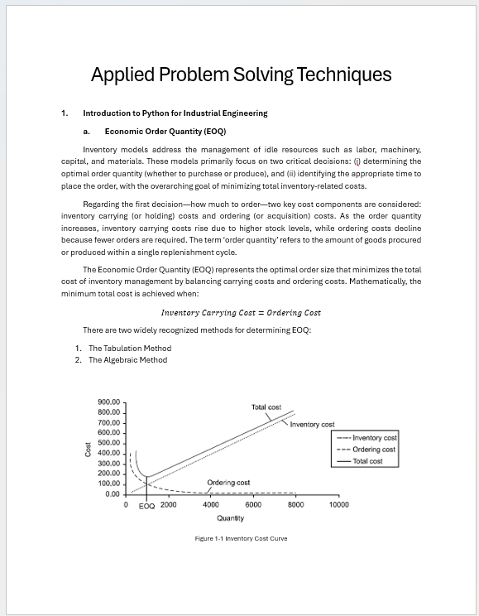
Practice
Solve the EOQ problem using the tabulation (trial-and-error) method (see table 1-1 in the lecture notes).
Determine the total cost for at least 8 different order frequencies (i.e., number of orders per year). And determine the EOQ.
Use Python loops to create and display the cost table and find the Economic Order Quantity (EOQ).

Slide 20
Questions ?

